Slide 1


2021 Action Plan Substantial Amendment #2
2022 Action Plan Substantial Amendment #1
Public Hearing – May 31, 2023

Slide 2
Presenter
Jed Drolet, Community Systems Program Manager

Slide 3
The HUD Planning Process

Slide 4
Qualitative Data
Required Plans
5-year Consolidated Plan
Annual Action Plan
Consolidated Annual Performance and Evaluation Report (CAPER)

Slide 5
AHD Programs Covered by Con Plan
CDBG: Community Development Block Grant
HOME: HOME Investment Partnerships Program
ESG: Emergency Solutions Grant
HTF: National Housing Trust Fund

Slide 6
Substantial Amendment

Slide 7
Substantial Amendments
Required when we make a major change to Action Plan
Go through public process
  30-day comment period
  Public Hearing (this one)
  Assembly Approval

Slide 8
Substantial Amendments
Making changes to 2021 and 2022 Action Plans:
  Allocating “TBD” HOME and CDBG funds to Cook Inlet Housing Authority for Spenard East Phase 2 Project
Draft on website: https://tinyurl.com/AHD-CSD

Slide 9
Substantial Amendment to 2021 Action Plan
Allocating money from “TBD” to a specific project
Grantee: Cook Inlet Housing Authority
Project: Spenard East Phase 2
Program: HOME
Amount: $501,452

Slide 10
Substantial Amendment to 2022 Action Plan
Allocating money from “TBD” to a specific project
Grantee: Cook Inlet Housing Authority
Project: Spenard East Phase 2
Program: HOME and CDBG
Amount: $533,641 total
  $411,942 HOME
  $121,699 CDBG

Slide 11
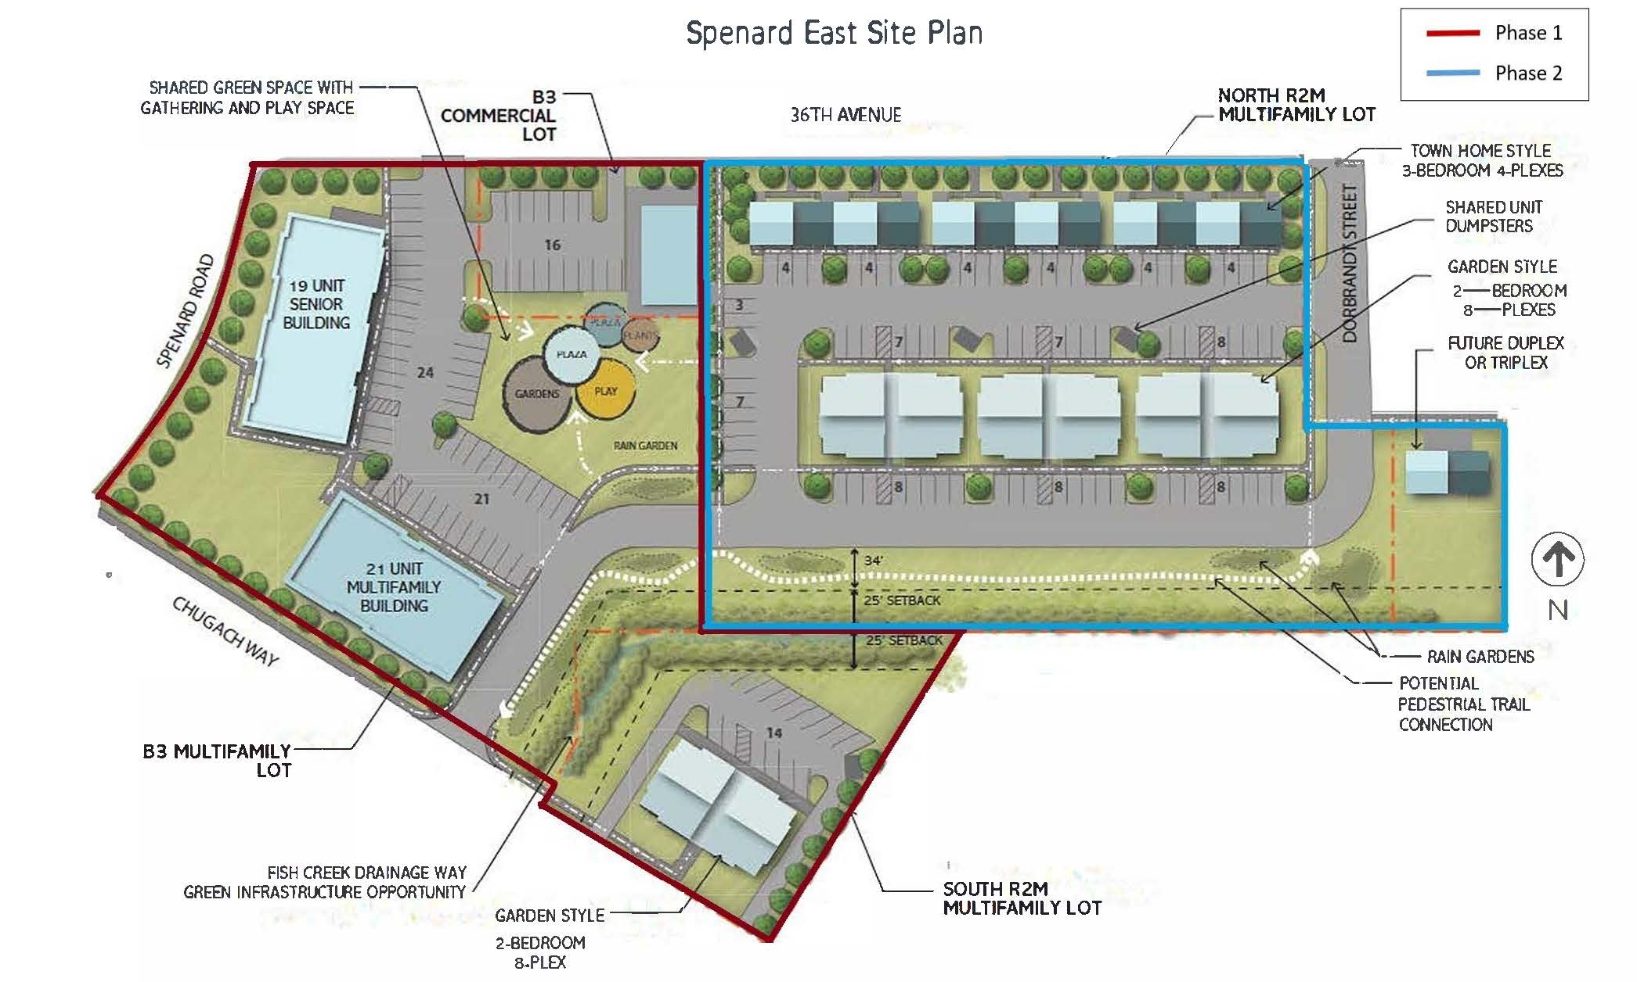
Spenard East Phase 2

Slide 12
Comment Period
May 21 to June 20, 2023
Minimum 30 days
We’ll still accept comments after though!
Will be additional opportunity for comment before the Assembly

Slide 13
How to Comment
Speak up now!
Email to ahdcsdplans@anchorageak.gov
Mail to:
  Anchorage Health Department
  Community Safety and Development
  P.O. Box 196650
  Anchorage, AK 99519

Slide 14

Questions?

Slide 15

Thank you!
Contact info:
Jed Drolet
Anchorage Health Department
(907) 343-4285
ahdcsdplans@anchorageak.gov

