Slide 1
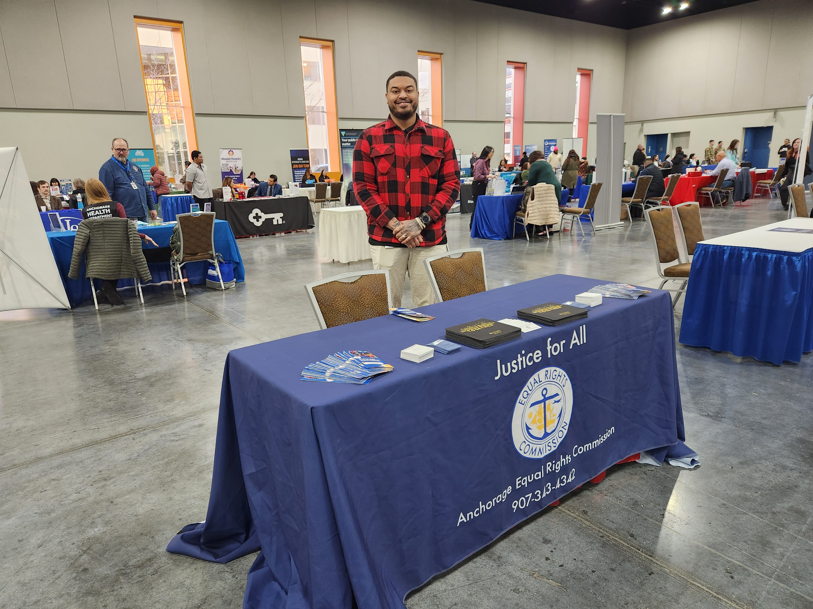
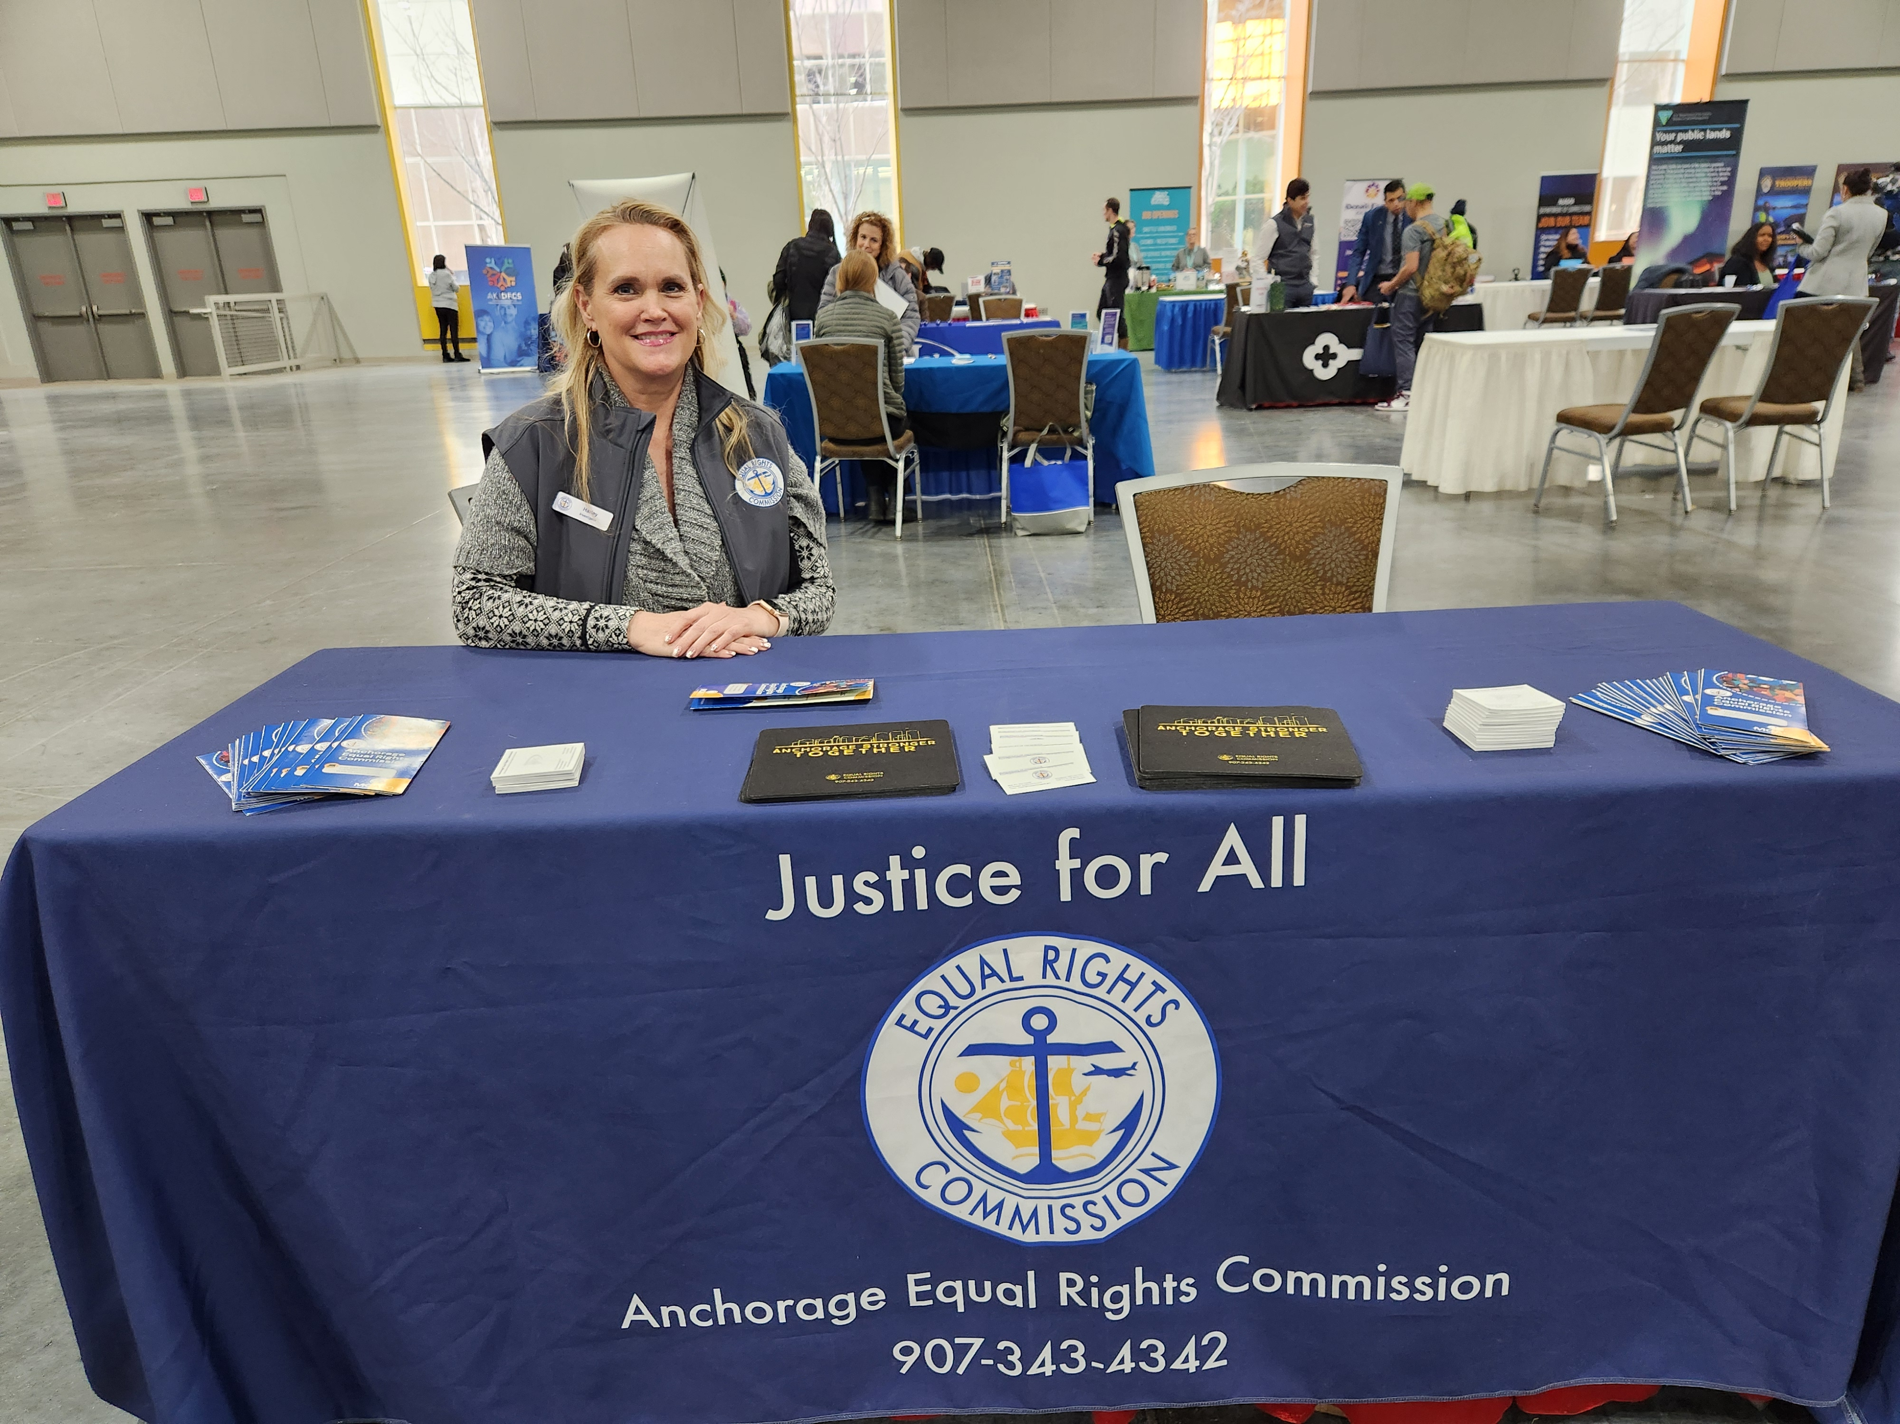
Anchorage Equal Rights Commission
Executive Director’s Update
Date: February 2026
Jennifer M. Booz, Executive Director
Investigators Cade and Harley at the Anchorage Mayor’s Career Fair, January 2026

Slide 2
Key Highlights Since Last Report
Superior Court Appeal-AERC finding upheld, January 2026
Would the commission like the court finding? Or a briefing from Legal?
Time Matters software- funds allocated, waiting on scheduling from IT
Executive Director selected for inaugural Municipality Leadership Program
9-week cohort by Anchorage-based Professional Growth Systems
2025 Annual Report complete-in design stage

Slide 3
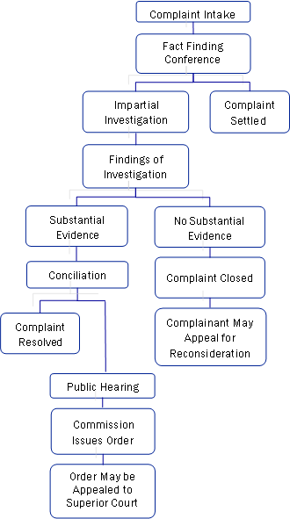
Cases- Month of January
Closures
Closed 8 cases
Average time in process-186 days
Inquiries and New Cases
39 inquiries
100% contacted within 24 hours
3 perfected complaints accepted
Pending Cases
34 open
Average time in process-164 days

Slide 4

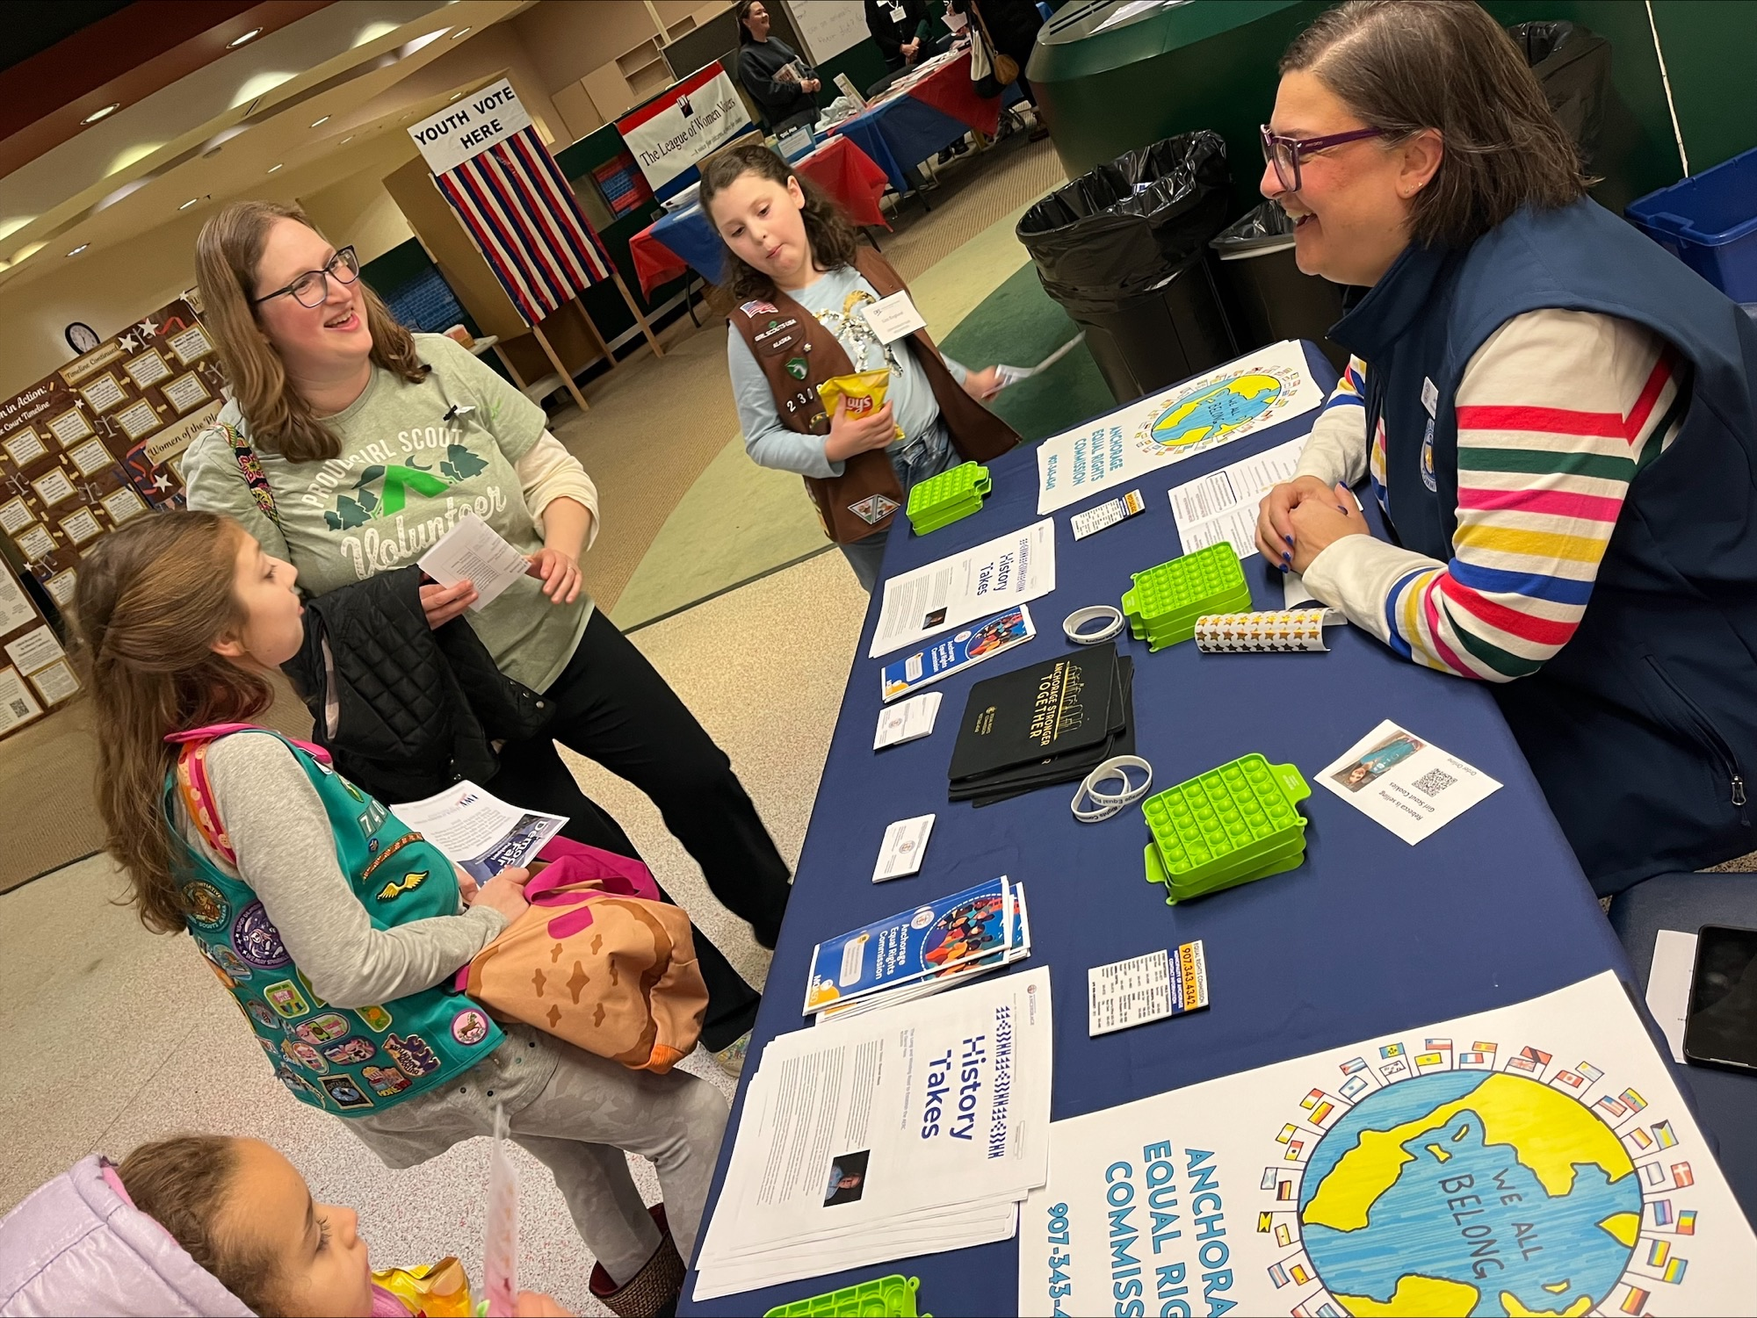
Community Outreach & Education
Two NEW Events:
Democracy Fair, January 10th
Mayor’s Annual City-Wide Job Fair, January 22nd
Executive Director Booz at the Democracy Fair, January 2026

Slide 5
Challenges & Opportunities
Challenges:
Investigator staffing changes
Time Matters upgrade transition
MOA budget
Opportunities:
Education
Outreach
Commissioner Training

