Slide 1
2021 Action Plan Substantial Amendment #1
Public Hearing – September 28, 2022

Slide 2
Presenter
Jed Drolet, Senior Neighborhood Planner

Slide 3
Public Health: working for all of us all of the time!

Slide 4
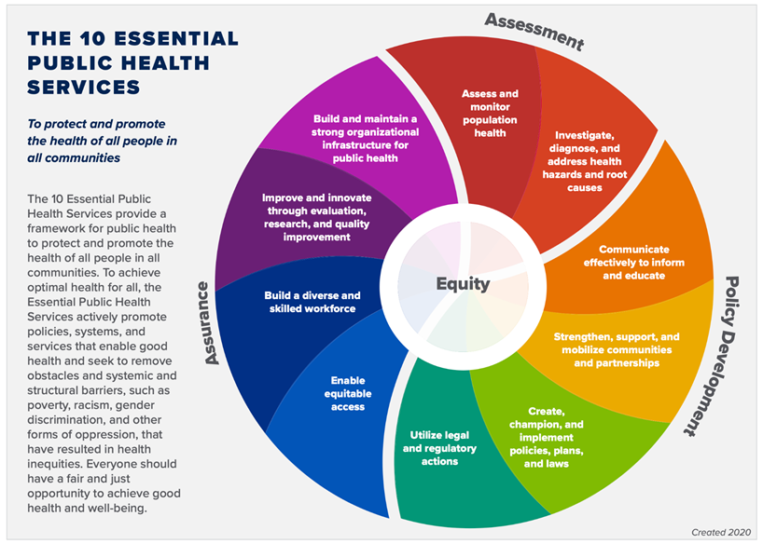
10 Essential Public Health Services

Slide 5
The HUD Planning Process

Slide 6
Qualitative Data
Required Plans
5-year Consolidated Plan
Annual Action Plan
Consolidated Annual Performance and Evaluation Report (CAPER)

Slide 7
AHD Programs Covered by Con Plan
CDBG: Community Development Block Grant
HOME: HOME Investment Partnerships Program
ESG: Emergency Solutions Grant
HTF: National Housing Trust Fund

Slide 8
Substantial Amendment

Slide 9
Substantial Amendments
Required when we make a major change to Action Plan
Go through public process
30-day comment period
Public Hearing (this one)
Assembly Approval

Slide 10
Substantial Amendment to 2021 Action Plan
Making two changes:
Allocating “TBD” HOME funds to Habitat for Humanity
Reallocating ESG funds from Anchorage Coalition to End Homelessness to Aging and Disability Resource Center
Draft on website: https://tinyurl.com/AHD-CSD

Slide 11
Substantial Amendment to 2021 Action Plan
Allocating money from “TBD” to a specific project
Grantee: Habitat for Humanity Anchorage
Project: Homebuyer Development Program
Program: HOME
Amount: $501,452

Slide 12
Substantial Amendment to 2021 Action Plan
Reallocating money from one project to another
Current Grantee: Anchorage Coalition to End Homelessness
Proposed Grantee: Aging and Disability Resource Center
Actually part of AHD rather than a “grantee” proper
Project: Homelessness Prevention
Program: ESG
Amount: $143,499

Slide 13
Comment Period
September 15 – October 17, 2022
Minimum 30 days
We’ll still accept comments after though!
Will be additional opportunity for comment before the Assembly

Slide 14
How to Comment
Speak up now!
Email to ahdcsdplans@anchorageak.gov
Mail to:
Anchorage Health Department
Community Safety and Development
P.O. Box 196650
Anchorage, AK 99519

Slide 15
Questions?

Slide 16
Thank you!
Contact info: Jed Drolet Anchorage Health Department
(907) 343-4285
ahdcsdplans@anchorageak.gov

