Slide 1
2023-2027 Consolidated Plan
2023 Action Plan
Public Hearing – July 18, 2023

Slide 2
Presenter
Jed Drolet, Community Systems Program Manager

Slide 3
The HUD Planning Process

Slide 4
Qualitative Data
Required Plans
5-year Consolidated Plan
Annual Action Plan
Consolidated Annual Performance and Evaluation Report (CAPER)

Slide 5
AHD Programs Covered by Con Plan
CDBG: Community Development Block Grant
HOME: HOME Investment Partnerships Program
ESG: Emergency Solutions Grant
HTF: National Housing Trust Fund

Slide 6
Funding Amounts
Program Year | CDBG | HOME | ESG | HTF
2023 | $1,872,494 | $773,536 | $166,518 | 0
2022 | $1,894,631 | $778,755 | $163,790 | 0
2021 | $1,948,478 | $748,644 | $155,133 | 0
2020 | $1,818,770 | $723,361 | $151,146 | 0
2019 | $1,720,154 | $663,207 | $146,461 | 0

Slide 7
Where We Are Now
2023-2027 Con Plan
Sets Goals for Action Plans
2023 Action Plan
Due August 16, 2023
Part of 2023-2027 Con Plan

Slide 8
Goals

Slide 9
Priority Needs – Proposed
Homeless Populations
Low-Income & Housed Populations
Public Facilities
Public Services

Slide 10
Goals - Proposed
Rental Housing Development
Homeowner Rehabilitation
Mobile Home Repair
Homeowner Development Program
Public Facilities
Public Services

Slide 11
Goals - Proposed
Tenant-Based Rental Assistance
Community Housing Development Organization Operating Expense Assistance
Economic Development
Homeless Prevention and Rapid Rehousing

Slide 12
Sample Projects

Slide 13
Community Development Block Grant – Recent Projects
RurAL CAP
Mobile Home Repair
Alaska Literacy Program
Vertical Lift & Arctic Entry
Brother Francis Shelter
Security Fence
Covenant House Alaska
Bridges to Success (Micro-Units)

Slide 14
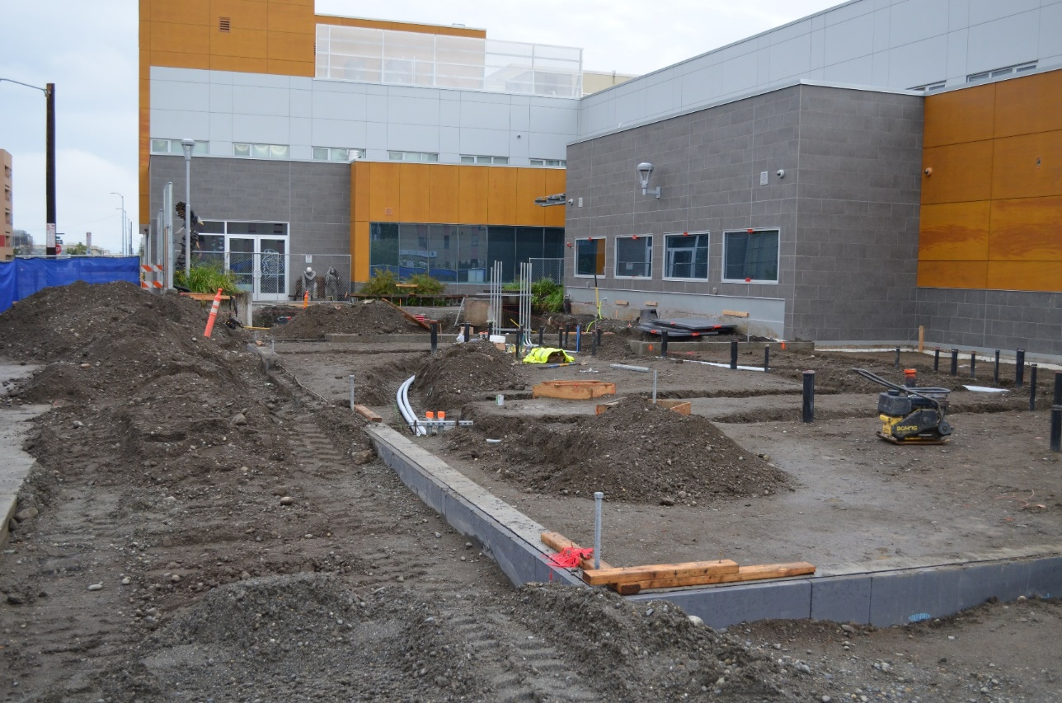
Community Development Block Grant – CHA Bridges to Success

Slide 15
Community Development Block Grant – Recent Services
Alaska Legal Services Program
Legal assistance to those at risk for homelessness
RurAL CAP
Homeless case management
Brother Francis Shelter
Referral Navigator program

Slide 16
HOME Investment Partnerships – Recent Projects/Services
Habitat for Humanity
Homebuyer Development Program (Duben Ave.)
NeighborWorks Alaska
Tenant-Based Rental Assistance
Cook Inlet Housing Authority
Elizabeth Place
Duke’s Downtown

Slide 17
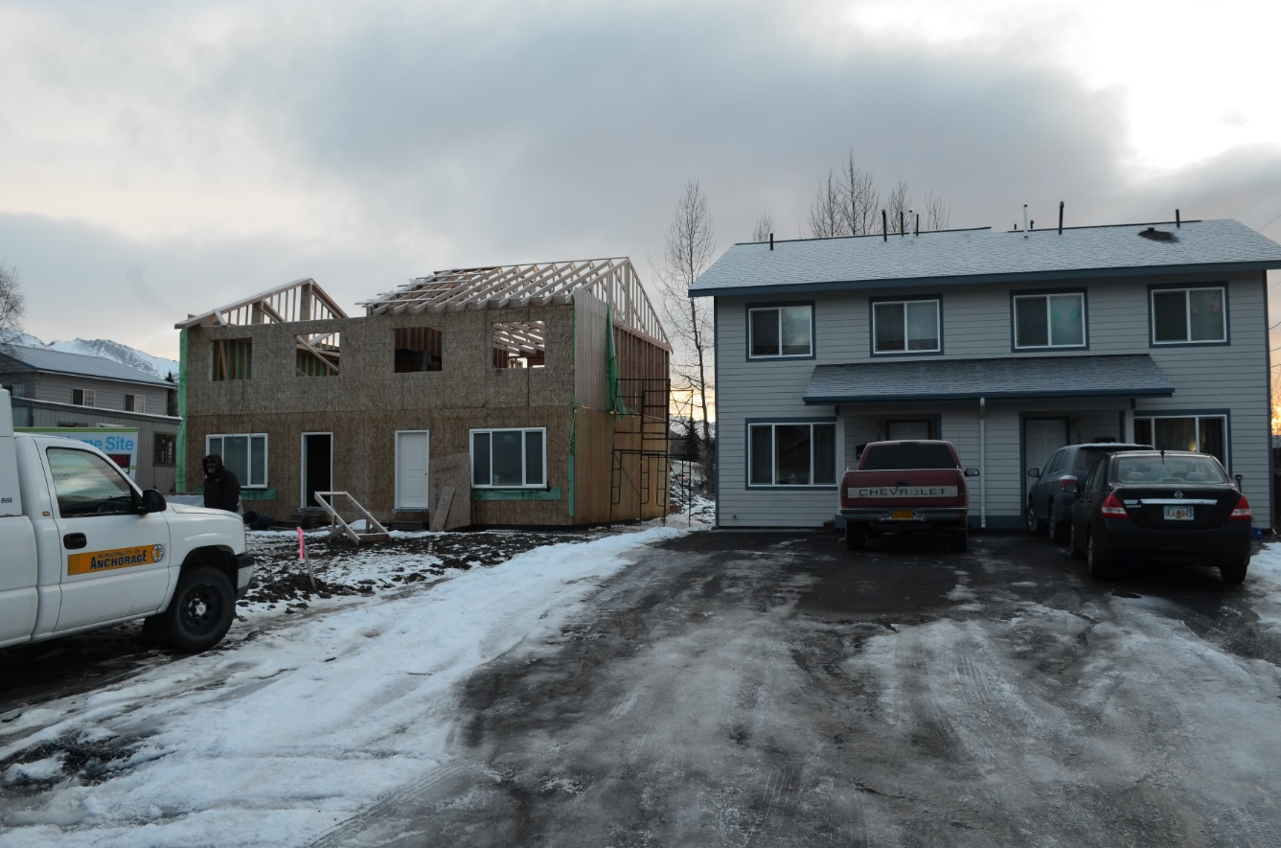
HOME Investment Partnerships – Habitat for Humanity Duben Ave.

Slide 18
Emergency Solutions Grants – Recent Programs
Homeless Prevention
Rapid Re-Housing
Homeless Outreach
Shelter Operations

Slide 19
Proposed Projects – 2023 Action Plan
Projected Funding Sources | CDBG
2023 Allocation | $ 1,872,494
Program Income | $ -
Total Sources | $ 1,872,494
Project Name
CDBG Administrative | $ 374,499
Mobile Home Repair | $ 400,000
TBD - Acquisition | $ 750,608
Activity Delivery Costs | $ 66,513
Public Services - Choosing Our Roots | $ 70,000
Public Services Sitka Place Case Management - Rural CAP | $ 71,560
Public Services Residential Re-entry – New Life Development | $ 75,000
Public Services Homeless Outreach - Rural CAP | $ 43,095
Public Services Net 2 Ladder – Nine Star | $ 21,219
Total | $ 1,872,494

Slide 20
Proposed Projects – 2023 Action Plan
Projected Funding Sources | HOME
2023 Allocation | $ 773,536
Program Income | $ -
Total Sources | $ 773,536
Project Name
HOME Administrative | $ 77,354
CHDO Operating Expense Habitat for Humanity | $ 38,677
CHDO Housing Development – Habitat for Humanity | $ 116,030
Housing Development – Habitat for Humanity | $ 166,475
Tenant Based Rental Assistance - NeighborWorks Alaska | $ 250,000
Rental Housing Development – Spenard East Phase 2 – Cook Inlet Housing Authority | $ 125,000
Total | $ 773,536

Slide 21
Proposed Projects – 2023 Action Plan
Projected Funding Sources | ESG
2023 Allocation | $ 166,518
Program Income | $ -
Total Sources | $ 166,518
Project Name
ESG Administrative | $ 12,489
Homelessness Prevention - ADRC | $ 154,029
Total | $ 166,518

Slide 22
Timeline

Slide 23
MOA Con Plan: 2023-2027
Note: Includes 2023 Action Plan
Public Meetings:
Winter 2022 – Spring 2023
Target Submission:
August 16, 2023
Assembly Approval:
August 2023
Public Comment Period/ Hearing:
July 2023
Public Notice of Draft:
July 2023
We Are Here

Slide 24
Consultation
HHAND Commission
ACEH/CoC
Federation of Community Councils
Individual Community Councils
Social Service Agencies
AHFC
Any other interested organization

Slide 25
Comment Period
July 7 – August 7, 2023
Minimum 30 days
We’ll still accept comments after though!
Great opportunity to provide feedback on Con Plan and Action Plan

Slide 26
How to Comment
Speak up now!
Email to ahdcsdplans@anchorageak.gov
Mail to:
Anchorage Health Department
Community Safety and Development
P.O. Box 196650
Anchorage, AK 99519

Slide 27
Questions?

Slide 28
Thank you!
Contact info: Jed Drolet Anchorage Health Department
(907) 343-4285
ahdcsdplans@anchorageak.gov

