Slide 1
2021 Consolidated Annual
Performance Evaluation Report
(CAPER)
Public Hearing – March 21, 2022

Slide 2
Presenter
Jed Drolet, Senior Neighborhood Planner

Slide 3
Public Health: working for all of us all of the time!

Slide 4
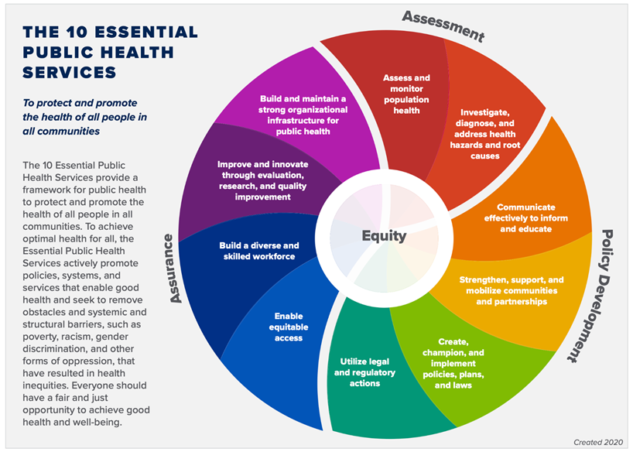
10 Essential Public Health Services

Slide 5
The HUD Planning Process

Slide 6
Qualitative Data
Required Plans
5-year Consolidated Plan
Annual Action Plan
Consolidated Annual Performance and Evaluation Report (CAPER)

Slide 7
AHD Programs Covered by CAPER
CDBG: Community Development Block Grant
HOME: HOME Investment Partnerships Program
ESG: Emergency Solutions Grant
HTF: National Housing Trust Fund

Slide 8
Funding Amounts
Program Year | CDBG | HOME | ESG | HTF
2021 | $1,948,478 | $748,644 | $155,133 | TBD
2020 | $1,818,770 | $723,361 | $151,146 | $550,000
2019 | $1,720,154 | $663,207 | $146,461 | 0
2018 | $1,726,068 | $733,068 | $145,198 | $733,068
2017 | $1,612,907 | $543,890 | $144,598 | $543,890

Slide 9
Goals

Slide 10
Priority Needs –MOA Con Plan
Homeless Populations
Low-Income & Housed Populations
Public Facilities
Public Services

Slide 11
Goals - MOA Con Plan
Rental Housing Development
Homeowner Rehabilitation
Mobile Home Repair
Homeowner Development Program
Public Facilities
Public Services

Slide 12
Goals - MOA Con Plan
Tenant-Based Rental Assistance
Community Housing Development Organization Operating Expense Assistance
Economic Development
Homeless Prevention and Rapid Rehousing

Slide 13
2021 CAPER

Slide 14
2021 CAPER
Draft posted to website: https://tinyurl.com/AHD-CSD
Covers expenditures during calendar year 2021, regardless of funding source year
Longer-term projects (e.g., construction) are included when completed
Some outcome indicators show zeroes because projects are not complete

Slide 15
Funding and Expenditures
Program | 2021 Funding | Amount Expended in 2021
CDBG | $1,948,478 | $1,610,689
HOME | $1,036,644 | $441,497
ESG | $155,133 | $49,262
HTF | $1,579,222 | $784,384
CDBG COVID 1 | $1,070,086 | $57,129
ESG COVID 1 | $521,193 | $404,641
ESG COVID 2 | $3,774,024 | $1,730,637

Slide 16
Affordable Housing
 | One-Year Goal | Actual
Number of Homeless households to be provided affordable housing units | 36 | 145
Number of Non-Homeless households to be provided affordable housing units | 21 | 34
Total | 57 | 179

Slide 17
Homelessness Prevention
Number of Persons in Households | Total
Adults | 57
Children | 33
Total | 90

Slide 18
Rapid Re-Housing
Number of Persons in Households | Total
Adults | 106
Children | 30
Total | 136

Slide 19
Shelter
Number of Persons in Households | Total
Adults | 584
Children | 427
Total | 1,011

Slide 20
Street Outreach
Number of Persons in Households | Total
Adults | 288
Children | 1
Total | 289
Excludes 3 persons for whom age is unavailable

Slide 21
Comment Period
March 14-29, 2022
Minimum 15 days
We’ll still accept comments after though!
CAPER due to HUD March 31, 2022

Slide 22
How to Comment
Speak up now!
Email to ahdcsdplans@anchorageak.gov
Mail to:
Anchorage Health Department
Community Safety and Development
P.O. Box 196650
Anchorage, AK 99519

Slide 23
Questions?

Slide 24
Thank you!
Contact info: Jed Drolet Anchorage Health Department
(907) 343-4285
ahdcsdplans@anchorageak.gov

