Slide 1
2023-2027 Consolidated Plan
2022 Action Plan
2019 Action Plan Substantial Amendment #6
2020 Action Plan Substantial Amendment #1
Public Hearing – February 15, 2022

Slide 2
Presenter
Jed Drolet, Senior Neighborhood Planner

Slide 3
Public Health: working for all of us all of the time!

Slide 4
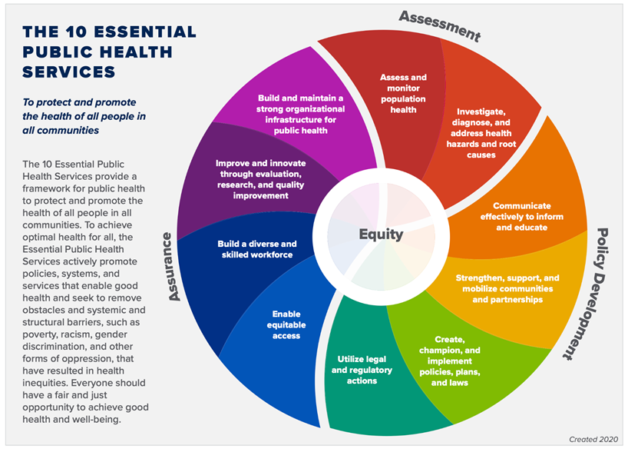
10 Essential Public Health Services

Slide 5
The HUD Planning Process

Slide 6
Qualitative Data
Required Plans
5-year Consolidated Plan
Annual Action Plan
Consolidated Annual Performance and Evaluation Report (CAPER)

Slide 7
AHD Programs Covered by Con Plan
CDBG: Community Development Block Grant
HOME: HOME Investment Partnerships Program
ESG: Emergency Solutions Grant
HTF: National Housing Trust Fund

Slide 8
Funding Amounts
Program Year | CDBG | HOME | ESG | HTF
2021 | $1,948,478 | $748,644 | $155,133 | TBD
2020 | $1,818,770 | $723,361 | $151,146 | $550,000
2019 | $1,720,154 | $663,207 | $146,461 | 0
2018 | $1,726,068 | $733,068 | $145,198 | $733,068
2017 | $1,612,907 | $543,890 | $144,598 | $543,890

Slide 9
Where We Are Now
2022 Action Plan
Due August 16, 2022
Tied to 2018-2022 Con Plan
2023-2027 Con Plan
Targeting November 2022
Developing New Goals

Slide 10
Goals

Slide 11
Priority Needs – Last MOA Con Plan
Homeless Populations
Low-Income & Housed Populations
Public Facilities
Public Services

Slide 12
Goals - Last MOA Con Plan
Rental Housing Development
Homeowner Rehabilitation
Mobile Home Repair
Homeowner Development Program
Public Facilities
Public Services

Slide 13
Goals - Last MOA Con Plan
Tenant-Based Rental Assistance
Community Housing Development Organization Operating Expense Assistance
Economic Development
Homeless Prevention and Rapid Rehousing

Slide 14
Sample Projects

Slide 15
Community Development Block Grant – Recent Projects
RurAL CAP
Mobile Home Repair
Alaska Literacy Program
Vertical Lift & Arctic Entry
Brother Francis Shelter
Security Fence
Covenant House Alaska
Bridges to Success (Micro-Units)

Slide 16
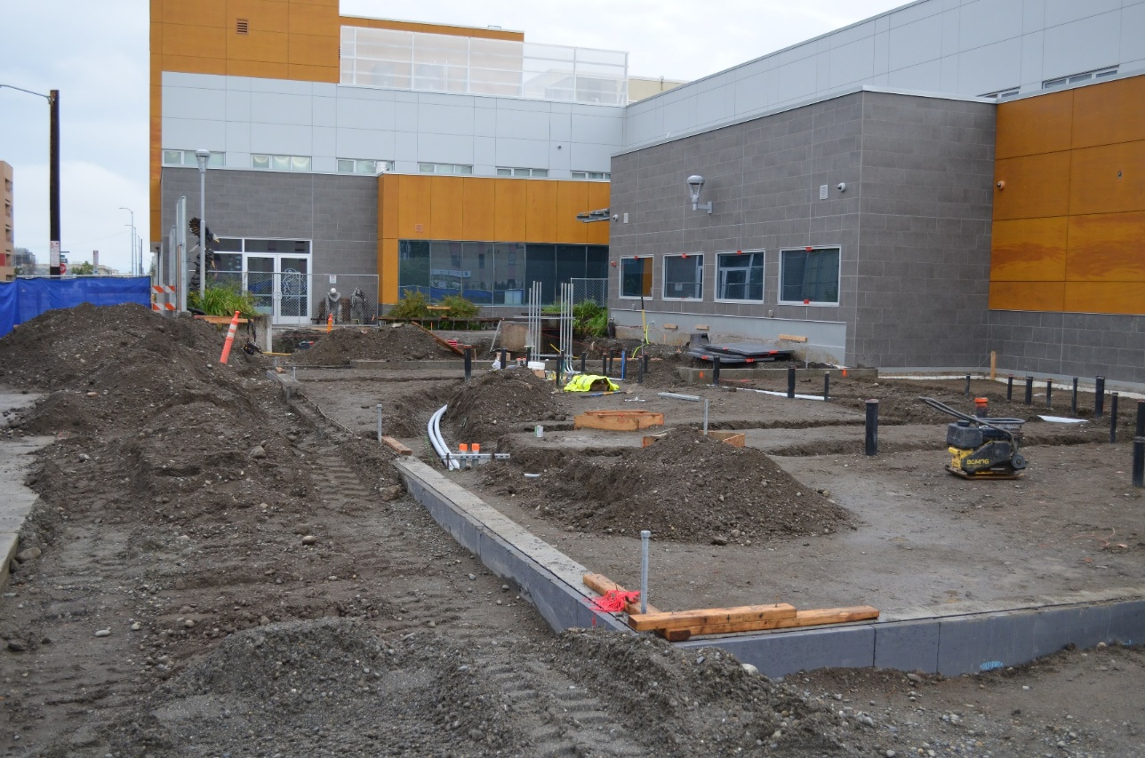
Community Development Block Grant – CHA Bridges to Success

Slide 17
Community Development Block Grant – Recent Services
Alaska Legal Services Program
Legal assistance to those at risk for homelessness
RurAL CAP
Homeless case management
Brother Francis Shelter
Referral Navigator program

Slide 18
HOME Investment Partnerships – Recent Projects/Services
Habitat for Humanity
Homebuyer Development Program (Duben Ave.)
NeighborWorks Alaska
Tenant-Based Rental Assistance
Cook Inlet Housing Authority
Elizabeth Place
Duke’s Downtown

Slide 19
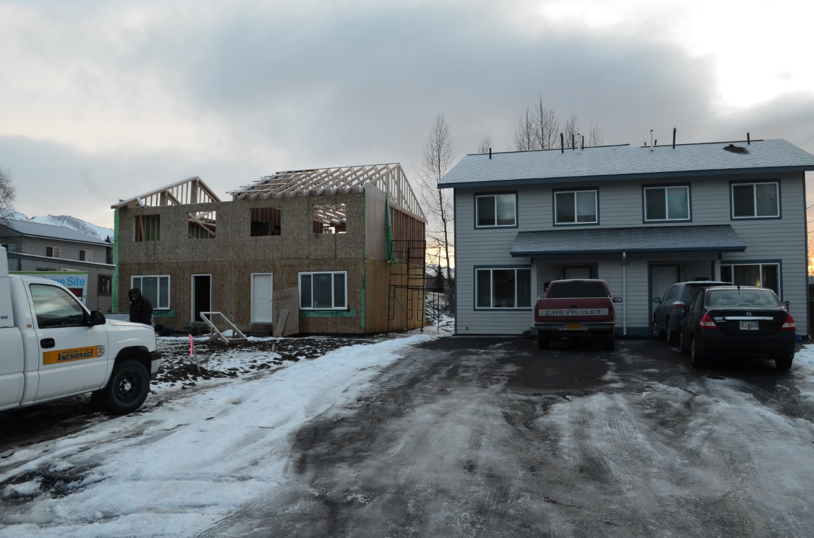
HOME Investment Partnerships – Habitat for Humanity Duben Ave.

Slide 20
Emergency Solutions Grants – Recent Programs
Homeless Prevention
Rapid Re-Housing
Homeless Outreach
Shelter Operations

Slide 21
Timeline

Slide 22
2022 Action Plan Timeline
Public Meetings:
Winter/Spring 2021-2022
Public Notice of Draft:
May 2022
Public Hearing on Draft:
June 2022
Submitted:
August 2022
Assembly Approval:
July 2022
We Are Here

Slide 23
Next MOA Con Plan: 2023-2027
Public Meetings:
Winter/Spring 2021/2022
Target Submission:
November 2022
Assembly Approval:
October 2022
Public Comment Period/ Hearing:
September 2022
Public Notice of Draft:
August 2022
We Are Here

Slide 24
Consultation
HHAND Commission
ACEH/CoC
Federation of Community Councils
Individual Community Councils
Social Service Agencies
AHFC
Any other interested organization

Slide 25
Substantial Amendments

Slide 26
Substantial Amendments
Allocating money from “TBD” to a specific project
Project: Nine Star Net2Ladder
2019 Action Plan: $29,579 CDBG Public Services
2020 Action Plan: $86,896 CDBG Public Services
Drafts on website: https://tinyurl.com/AHD-CSD
Comments: ahdcsdplans@anchorageak.gov

Slide 27
Nine Star Net2Ladder Program Description
“Nine Star’s Net2Ladder (N2L) will deliver services that prevent homelessness and improve the quality of life for all Alaskans. N2L services will reduce the ranks of individuals and their families in danger of losing stable housing. The services assist clients in readiness to get a job, improvement to obtain a new or improved employment, participate in activities to keep employment, and follow-up coaching to advance in their employment.”

Slide 28
Nine Star Net2Ladder Expected Outcomes
1. 75 job seekers will enroll in Net2Ladder job-readiness activities. GET A JOB!
2. 50 job seekers will obtain new or improved employment. GET A JOB!
3. 35 job seekers will agree to participate in KEEP A JOB! behavioral health activities.
4. 50 newly employed Alaskans will receive follow-up coaching to help them ADVANCE ON THE JOB!

Slide 29
Comment Period
February 8 – March 10, 2022
Minimum 30 days
We’ll still accept comments after though!
Great opportunity to provide ideas for Con Plan and Action Plan
Will be more comment periods in future stages of the process

Slide 30
How to Comment
Speak up now!
Email to ahdcsdplans@anchorageak.gov
Mail to:
Anchorage Health Department
Community Safety and Development
P.O. Box 196650
Anchorage, AK 99519

Slide 31
Questions?

Slide 32
Thank you!
Contact info: Jed Drolet Anchorage Health Department
(907) 343-4285
ahdcsdplans@anchorageak.gov

